Slide 1
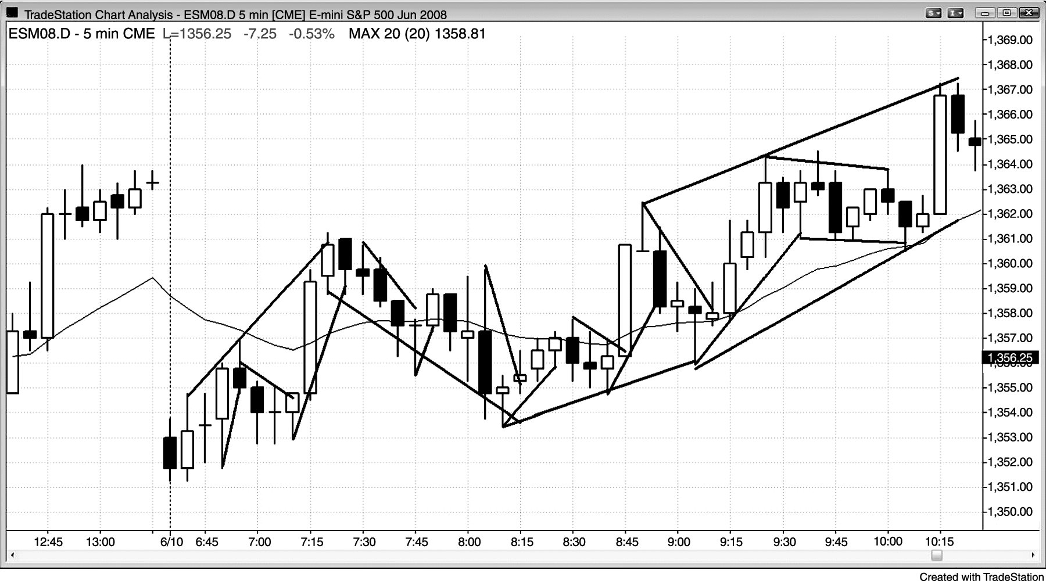
FIGURE 20.1 Every Leg Is Made of Smaller Legs

